Slide 1
FINAL PRESENTATION Coursera Capstone Project Data Science Specialization
The Idea of Starting Up a Turkish Restaurant
in Istanbul
Cihan Ersoy

Slide 2
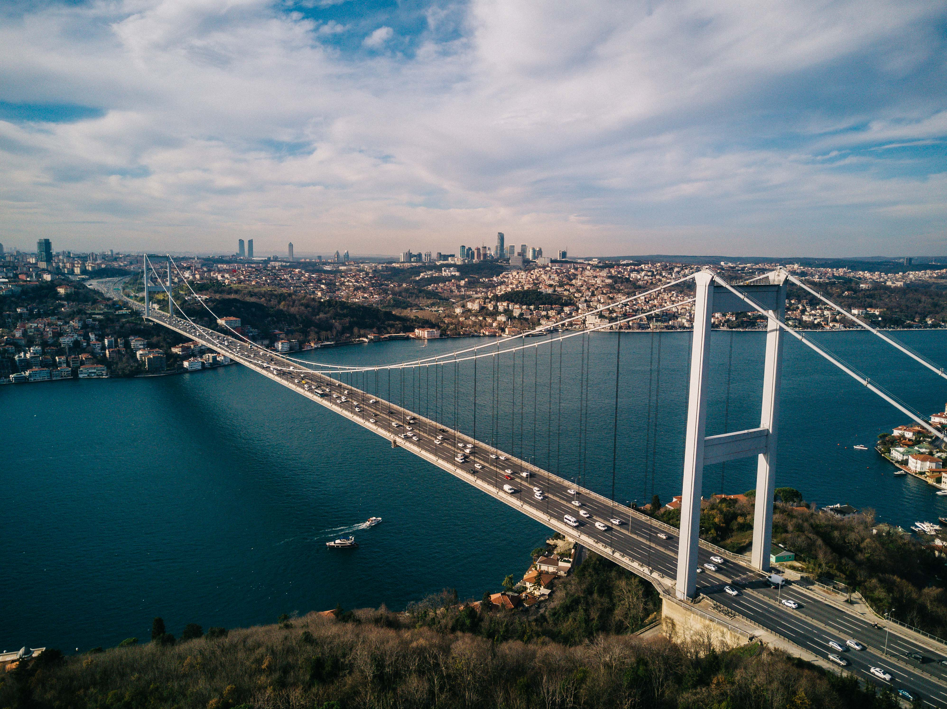
Istanbul, Turkey

Slide 3
Introduction
Turkish cousine is one of the most spectecular things in the world, and kebab is by far the most popular Turkish food of all. Therefore, there are many kebab shops in Istanbul, which is the most populated and most famous city in Turkey. Although restaurant industry is having hard times in 2020 due to pandemic, I believe there will be still room for opportunities after the virus is gone. For this reason, I have decided to make my capstone Project on opening a kebab restaurant in Istanbul. Because the location of a restaurant is a key factor for its success, using data science to determine it will be useful and profitable for our business.

Slide 4
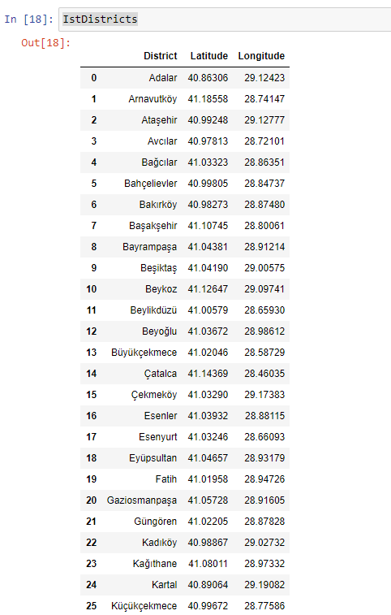
Some Districts and Their Coordinates of Istanbul

Slide 5
Business Problem
In this project, I am planning to provide an analysis of the location choices for a restaurant in such a big city like Istanbul. The city of Istanbul is full of opportunities only if you know where to look. Emerging technologies help us to use science to make better decisions instead of our gut feeling and instinctions. As a result, I will try to use data science to solve a business problem which is to find most proper location for a restaurant in Istanbul.

Slide 6
Target Audience
Target audience of this project is entrepreneurs, restaurant chefs, and investors who look for a new start-up business to put money in. Also the methods which are used throughout the project may draw technology enthusiasts' attention. Potential stakeholders should keep in mind that this project has been prepared in the year of 2020. Lots of restaurants and other businesses are going bankrupt because of ongoing pandemic. So the conclusion of this project may be irrelevant in coming years.

Slide 7
Data
The data below will be used to solve this problem.
. Neighborhood details of Istanbul. This will be the backbone of the project.
. Geographical details of the neighborhoods. This will help us for visualization.
.Restaurant details will be collected to use for clustering purposes.
.en.wikipedia.org/wiki/List_of_neighbourhoods_of_Istanbul seems to have necessary information.

Slide 8
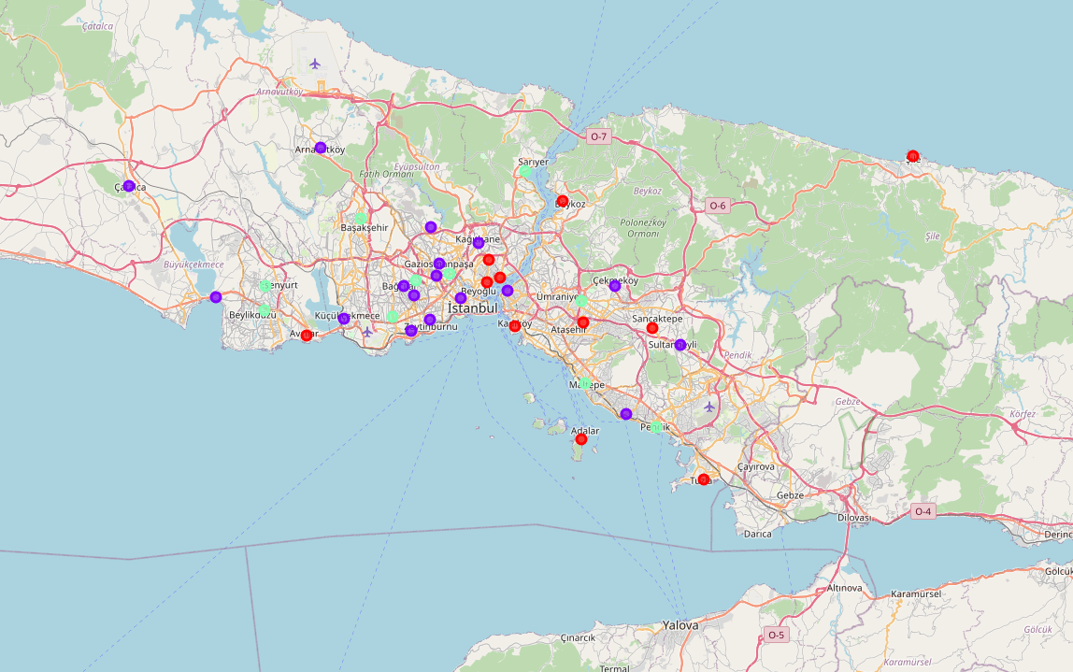
Clusters of Restaurants in Istanbul

Slide 9
DISCUSSION
Most of the shopping malls are concentrated in the central area of Kuala Lumpur city, with the highest number in cluster 2 and moderate number in cluster 0. On the other hand, cluster 1 has very low number to totally no shopping mall in the neighborhoods. This represents a great opportunity and high potential areas to open new shopping malls as there is very little to no competition from existing malls. Meanwhile, shopping malls in cluster 2 are likely suffering from intense competition due to oversupply and high concentration of shopping malls. From another perspective, this also shows that the oversupply of shopping malls mostly happened in the central area of the city, with the suburb area still have very few shopping malls. Therefore, this project recommends property developers to capitalize on these findings to open new shopping malls in neighborhoods in cluster 1 with little to no competition. Property developers with unique selling propositions to stand out from the competition can also open new shopping malls in neighborhoods in cluster 0 with moderate competition. Lastly, property developers are advised to avoid neighborhoods in cluster 2 which already have high concentration of shopping malls and suffering from intense competition.

